Slide 1
Tablet protection from Sunlight

Slide 2
Problem statement
Field Report
1. KOKOpoint tablet was found dim and blank with dull blue colored stripes.
2. The tablet was restarted, connectivity got restored just for few seconds before the tablet went totally blank with a yellow color.

Slide 3
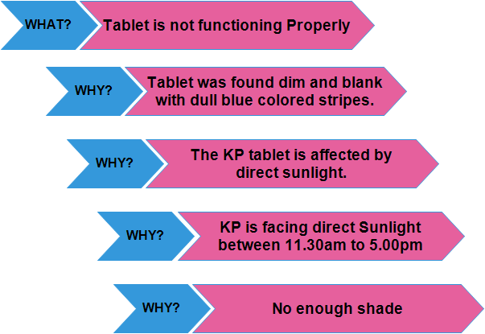
Root Cause analysis
Liquid Crystal Displays use organic components that are susceptible to UV and IR. These bandwidths of radiation have an observable impact on the organic components in LCDs. Extended exposure has been known to cause a color shift and a washed out look to images displayed with the LCD.
Over time the UV and IR radiation degrade the organic components causing them to fail to function properly.
Manufacturer Recommendation: Keep away from excess temperature(50°C above) & too cold(-10°C Below)

Slide 4
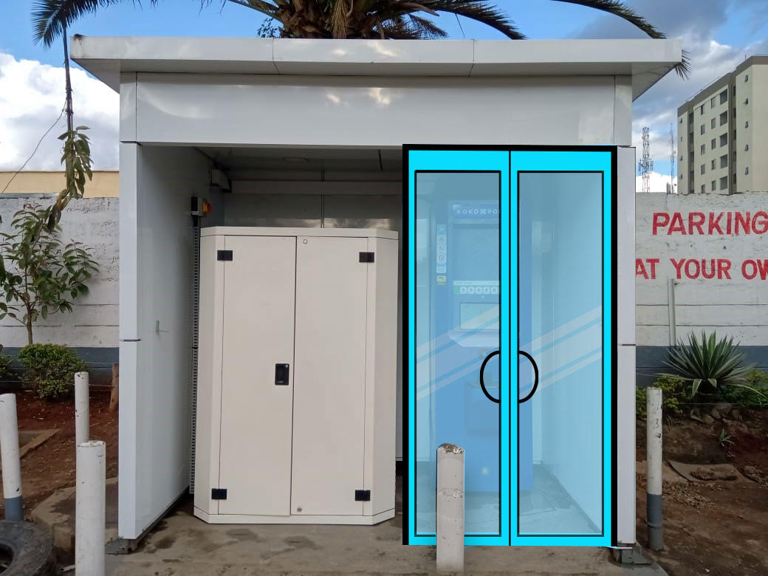
Possible solution - 1
Glass Door
A glass door zoning in front of the KOKOpoint.
The entire KOKOpoint and other parts(Controller module) is protected from sunlight with the installation of a glass door.
Sourcing: Local - Work in progress

Slide 5
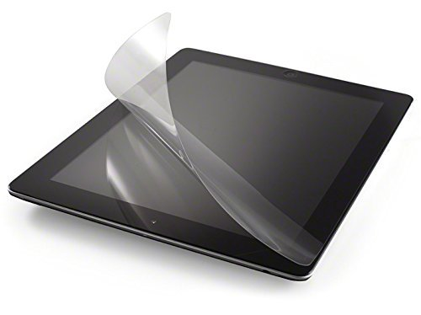
Possible solution - 2
Film with a UV blocker
LCD’s are likely to be harmed by overheating due to excess Infrared radiation. The KOKOpoint tablet is intended to operate within a certain range of temperatures according to the manufacturer’s instructions and outdoor use can lead to higher than normal temperatures.
The display being exposed to excessive heat can cause the crystal to become isotropic and fail to perform properly.
A film can help alleviate these concerns as well by reducing the amount of infrared radiation that heats the display.
Sourcing - US, UK & PRC - Work In progress.

Slide 6
Possible solution - 3
White Canvas Curtain - 0.8m*1.2m(W*L)
This is to cover the KP upto Screen Level.

Slide 7
y.koech@kokonetworks.com

